Slide 1
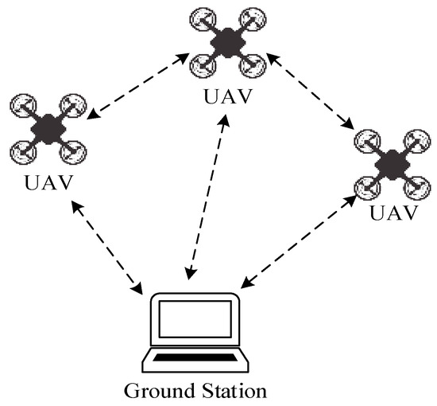
Employing Post Quantum Code Based Cryptography for Secure IoT-Based UAV Devices
By Rahul Manna(210) and Dhritiman Bhattacharya(212)
Under the supervision of Dr. Atanu Mandal, Assistant Professor,
Ramakrishna Mission Vidyamandira.
Advisor: Dr Arindam Sarkar(HOD), Assistant Professor, Ramakrishna Mission Vidyamandira

Slide 2

Securing IoT-Based UAVs with Post-Quantum Code-Based Cryptography
IoT devices are rapidly transforming modern applications, projected to exceed 75 billion by 2025. They enable automation, monitoring, and control across various industries. Use cases range from precision farming and remote healthcare to UAV applications for delivery and surveillance.
IoT ecosystems rely on data-driven decision-making, leveraging real-time analytics and AI/ML-powered predictions. Data integrity and security are paramount, protecting sensitive information and ensuring trustworthy operations.
This presentation introduces the importance of post-quantum code-based cryptography for securing IoT-based UAV devices, highlighting the need to protect against quantum computing threats and the role of code-based cryptographic techniques.

Slide 3

Post-Quantum Code-Based Cryptographic Techniques
Need for Post-Quantum Cryptography (PQC)
Code-Based Cryptography
Quantum computers threaten current cryptographic algorithms, necessitating the development of Post-Quantum Cryptography (PQC). NIST's PQC standardization project has selected algorithms for future use.
Code-based cryptography, such as the McEliece and Niederreiter cryptosystems, offers high security and resistance to quantum attacks, but faces challenges with large key sizes and complexity.
Advantages
High security, resistance to quantum attacks
Well-studied mathematical foundations with decades of analysis
Robustness against cryptanalysis even with quantum capabilities
Relatively fast encryption and decryption operations compared to some other PQC schemes
Lightweight Implementations
Trade-offs between security and performance must be made to accommodate resource constraints in UAVs. For instance, the Kyber algorithm was selected by NIST.

Slide 4



Summary and Implications for Secure IoT-Based UAV Devices
Enhancing UAV Security
Protects UAVs from cyberattacks and data breaches, ensuring safe and reliable operations and maintaining public trust.
Future Research Directions
Focus on optimizing code-based cryptography, developing hybrid PQC solutions, and exploring new code families for improved performance.
Broader Impact on IoT Security
Securing IoT ecosystems from quantum threats, enabling widespread adoption of IoT technologies, and supporting innovative applications.
Employing post-quantum code-based cryptography will have a broader impact on IoT security, securing IoT ecosystems from quantum threats and enabling the widespread adoption of IoT technologies. Future research should focus on optimizing code-based cryptography for resource-constrained devices and developing hybrid PQC solutions for enhanced security.

Slide 5
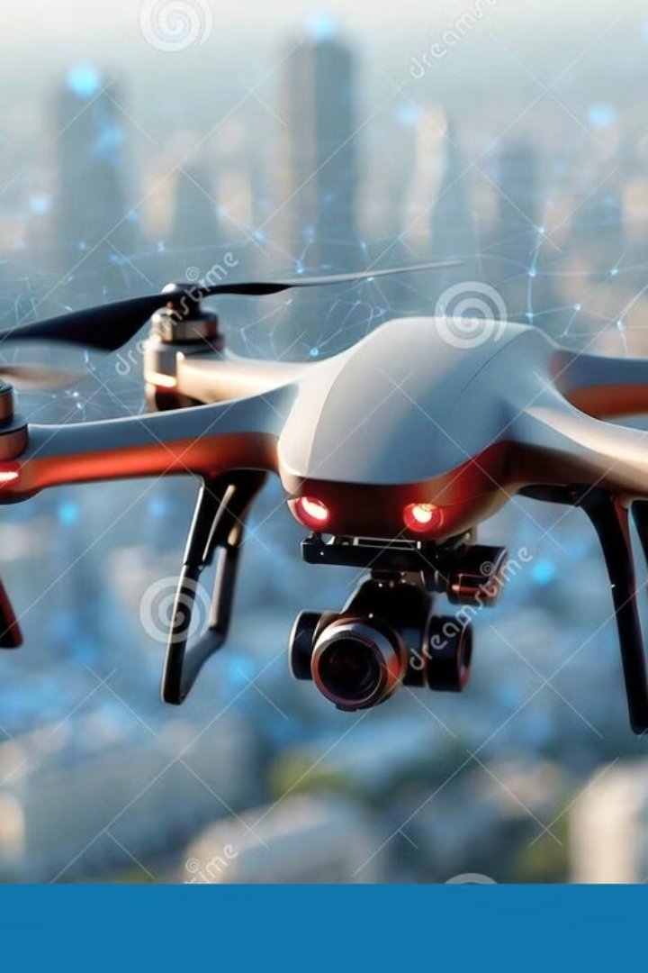
Literature Survey: Secure IoT-Based UAV Devices
This chapter provides an in-depth review of security challenges in IoT communication, particularly focusing on Unmanned Aerial Vehicles (UAVs) integrated with IoT technology. It examines the limitations of classical cryptographic methods against emerging quantum threats and explores various post-quantum cryptographic algorithms. Our objective is to identify existing research gaps and motivate a novel approach centered on post-quantum code-based cryptography to bolster UAV-IoT security.

Slide 6
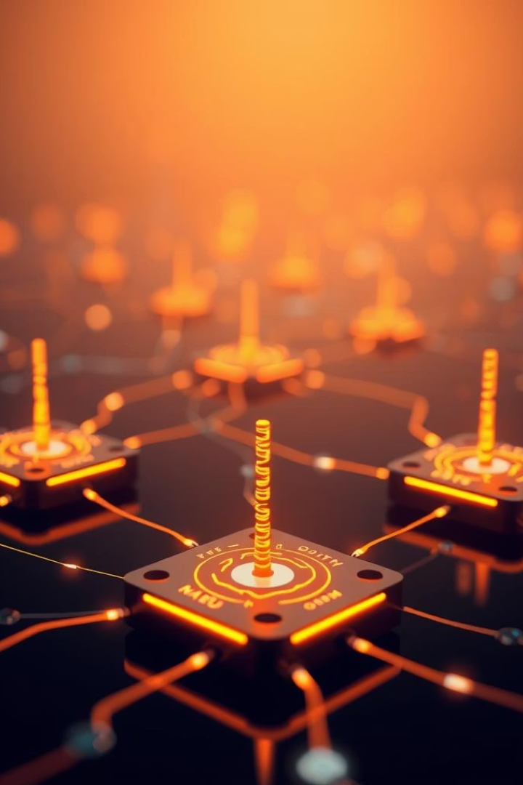
Security Challenges in IoT Communication & Classical Crypto Limitations
Vulnerabilities in IoT Protocols
Key Security Requirements
Wireless protocols like IEEE 802.11 and Bluetooth are susceptible to interception and tampering, exposing IoT devices to potential cyberattacks.
Ensuring data integrity, robust authentication, and confidentiality is critical for safe IoT communication, especially in UAV applications.
Classical Cryptography Limitations
Widely used algorithms such as AES, RSA, and ECC are vulnerable to quantum attacks like Shor's or Grover's algorithms, threatening future security.
For example, RSA-2048, currently deemed secure, may become obsolete with the advent of sufficiently powerful quantum computers.

Slide 7
Post-Quantum Cryptographic Algorithms: Comparative Review
Code-Based Cryptography
Lattice-Based Cryptography
Other PQC Algorithms
Algorithms like McEliece and Niederreiter offer high-security parameters and are strong candidates for quantum resistance.
Multivariate cryptography (Rainbow) assessed for security levels
CRYSTALS-Kyber and CRYSTALS-Dilithium are notable for balancing security and performance, making them attractive for practical use.
Hash-based signatures (SPHINCS+) present unique advantages and trade-offs
The analysis focuses on security strength, key sizes, computational costs, and implementation challenges, informing the selection of appropriate algorithms for UAV-IoT systems.

Slide 8
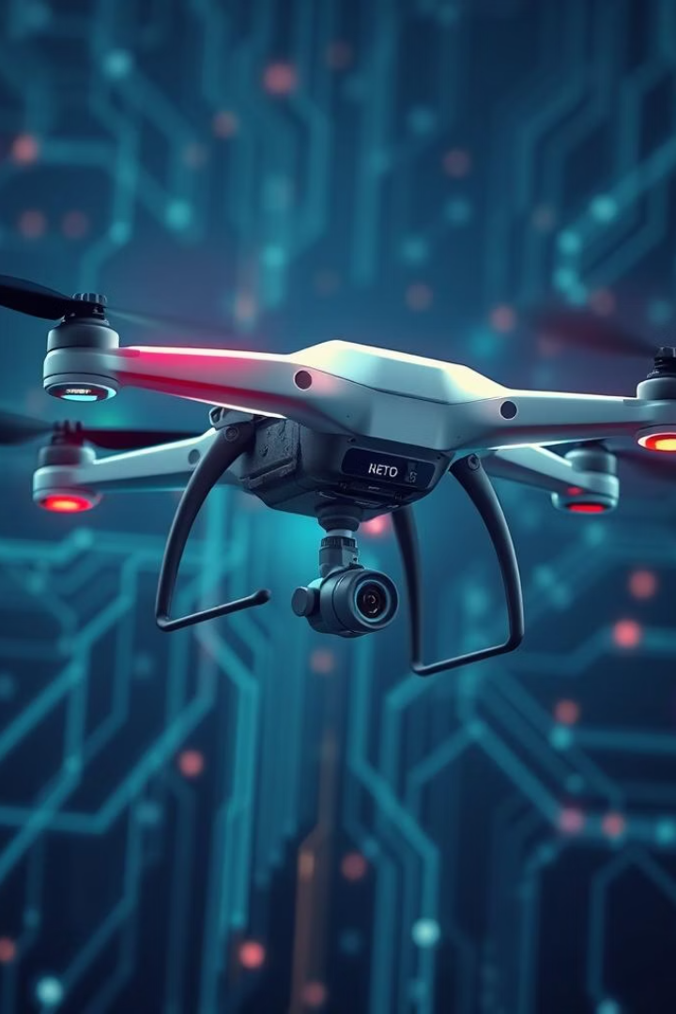
Prior Implementations & Summary of Gaps/Motivation
Current UAV-IoT Security Approaches
Identified Gaps
Most rely on classical cryptographic measures which lack resistance to quantum computing threats.
There is limited research focused on incorporating code-based post-quantum cryptography in UAV-IoT ecosystems.
Research Motivation
To develop and implement quantum-resistant cryptographic solutions that strengthen data confidentiality, authentication, and integrity for UAV-IoT communications.
This approach aims to future-proof UAV operations by addressing emerging quantum threats and enhancing overall security posture in IoT networks.

Slide 9
Proposed IoT-UAV Communication Architecture
Communication Layers
Core Components
IoT Devices: Sensors and actuators collecting environmental and positional data such as temperature and GPS coordinates.
The communication stack spans multiple layers including Physical, Data Link, Network, Transport, Application, and the critical Cryptographic Layer that enhances security at every step.
UAV: Equipped with onboard computers, communication modules, and flight controllers to process and relay data securely.
This layered design supports reliable and protected data flow, addressing the complexities of both aerial and ground communication environments.
Ground Station: Central hub for data processing, command control, and secure data storage.

Slide 10

Cryptographic Layer: McEliece Integration
McEliece Implementation
Data Flow & Security
Generates a strong public/private key pair, encrypting sensor data at IoT nodes and decrypting it securely at the ground station.
Encrypted sensor data is relayed securely via UAV to the ground station, ensuring confidentiality and integrity throughout transmission.
Secure Channel & Protocols
Hybrid post-quantum-resistant key exchange protocols combine with IoT-standard protocols like MQTT and CoAP, ensuring seamless integration and secure communication.

Slide 11

System Requirements and Assumptions
Security Requirements
Performance Targets
Confidentiality: Ensured by end-to-end encryption.
Latency: Maximum 100ms delay for time-sensitive operations.
Integrity: Validated by SHA-3 to detect any tampering.
Throughput: Minimum 1 Mbps to handle continuous sensor data.
Authentication: Strong digital signatures guaranteeing device legitimacy.
Optimization: Tailored for the limited processing power of IoT components.
Assumptions
Adversary capable of quantum attacks, necessitating post-quantum cryptography.
Trusted, secure key management infrastructure to maintain system integrity.

Slide 12
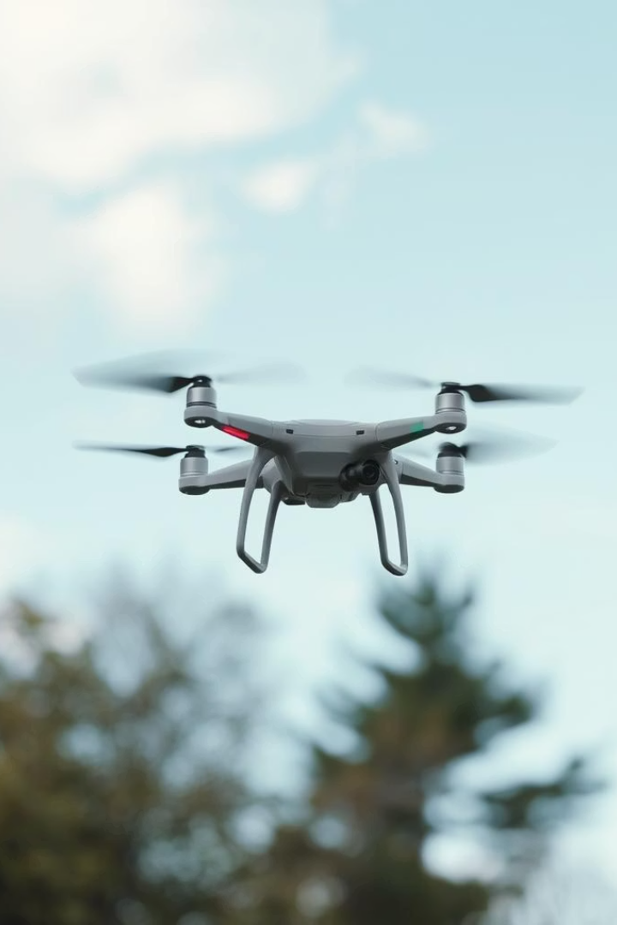
Development Process and Toolchain for PQC-Enabled UAVs
Software Stack & Tools
FreeRTOS for real-time task management
Hardware Stack
STM32H7 flight controller with ARM Cortex-M7 core and cryptographic acceleration
MAVLink protocol for telemetry and control
Libpq Crypto library optimized for embedded PQC implementations
Wi-Fi 6 module supporting IEEE 802.11ax and AES-256 encryption
Development tools: Python, JupyterLab, PennyLane for rapid prototyping and quantum analysis
IMU (MPU9250), GPS (U-blox NEO-M8N), and Barometer (BMP280) sensors
GCC ARM Embedded for compilation and OpenOCD for debugging

Slide 13

Post-Quantum Cryptography Integration and Simulation
Code-Based Cryptography Implementation
Integration Points & Simulation
Leveraging the McEliece algorithm for high security, this implementation uses 2048-bit public and 1024-bit private keys. Encryption utilizes Goppa codes, with syndrome decoding for decryption. Optimization exploits AVX2 and NEON instruction sets to enhance performance across hardware platforms.
Secure boot processes use PQC signatures for firmware authentication. Command and control channels implement PQC-based key exchanges, while sensitive data is encrypted at rest. Simulations include software-in-the-loop with Flightmare and hardware-in-the-loop with PX4 autopilot, complemented by fuzz testing for vulnerability detection.

Slide 14
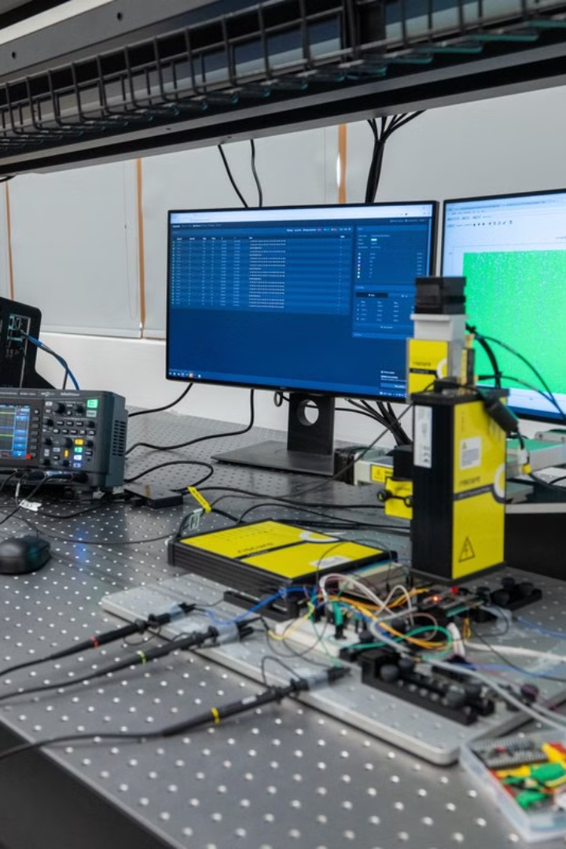
Challenges Faced and Mitigation Strategies
Computational Overhead
Key Size and Storage
McEliece decryption incurs a 20x performance hit compared to ECC. Mitigations include optimized code paths, hardware acceleration, and hybrid cryptographic schemes balancing security and efficiency.
PQC key sizes are substantially larger, demanding key compression and secure storage solutions like Trusted Platform Modules to manage storage constraints effectively.
Standardization and Distribution
Ongoing NIST PQC standardization drives flexible, modular designs that support emerging protocols. Secure key distribution strategies include quantum key distribution and trusted pre-shared arrangements.
Integrating PQC significantly fortifies UAV security against quantum threats, though ongoing research is vital to optimize performance and ensure broad adoption.

Slide 15

Performance Analysis: PQC Techniques for UAVs
Algorithm
Key Size
Encryption/Decryption Speed
Signature Size
Security Basis
McEliece
1MB+
Fast
N/A
Code-based, proven security
Kyber
1KB
Fast
N/A
Lattice-based
Given the limited computational resources and strict latency requirements of IoT-based UAVs, this comparison highlights the trade-offs between key size and operational speed. McEliece, while demanding larger keys, offers robustness ideal for secure UAV communications.

Slide 16
Security and Power: Verification & Quantum Attack Resistance
Communication Security Metrics
Power Consumption & Resistance
Packet Loss Rate under quantum attacks
Energy per operation for McEliece vs Kyber (mW)
Throughput impact from PQC implementation
Bit Error Rate during quantum attacks
Latency changes due to encryption/decryption
Resistance against Grover’s & Shor’s algorithms
Analysis shows that PQC algorithms impose varying degrees of additional latency and energy demands. McEliece’s larger key size requires higher power but provides robust defense, crucial for UAV communications facing quantum threats.

Slide 17

Conclusion: Towards Quantum-Resistant UAVs
Promising Security
McEliece offers strong quantum resistance by trading off key size for proven robustness, making it suitable for UAV security.
Future Optimization
Efforts should focus on optimizing PQC algorithms to fit the limited power and computational resources of IoT UAV devices.
Research Direction
Development of lightweight, efficient PQC approaches will be key to achieving secure and practical communication systems.
Goal
Ensuring reliable, quantum-resilient UAV communications to secure IoT networks against evolving cyber threats.

Slide 18

Limitations and Optimization Areas
Key Size Constraints
Extended key sizes restrict the deployment on low-power and resource-limited IoT devices, necessitating efficient compression techniques or alternative variants.
Memory Footprint
Optimization of memory usage in embedded systems is critical to enable McEliece’s practical application in constrained environments.
Security Concerns
Vulnerabilities to side-channel attacks require the development of hardware-based countermeasures to prevent leakage of sensitive information.
Performance Bottlenecks
Inefficiencies in key generation and distribution processes limit scalability and call for formal verification to ensure robustness.

Slide 19
Future Work: Long-Term Viability of PQC in IoT
Hybrid PQC Schemes
Lightweight Variants
Blockchain-Enabled Key Management
Developing streamlined McEliece versions targeted for IoT enhances compatibility with constrained devices.
Employ hybrid approaches combining McEliece with other algorithms to reduce key sizes while boosting security strength.
Integrating blockchain can decentralize trust and improve the security of cryptographic key distribution across IoT networks.
Real-World Validation
Quantum-Resistant Updates
Extensive deployment and testing in real environments will be essential to assess performance and scalability.
Implementing secure firmware updates resistant to quantum attacks ensures long-term security of IoT devices.

Slide 20

Future Research Directions
Post-Quantum Signatures
Exploration of quantum-resistant digital signature schemes for strong authentication mechanisms.
Hardware Acceleration
Designing dedicated hardware accelerators to optimize McEliece cryptographic operations and increase efficiency.
Homomorphic Encryption
Integration for secure computation on encrypted data, allowing privacy-preserving processing in IoT.
Quantum Key Distribution
Investigating secure quantum key exchange techniques tailored for IoT network environments.
Algorithmic Resilience
Studying advanced quantum computing algorithms to continuously fortify cryptographic defenses.

Slide 21
THANK YOU

